Slide 1

Presentation On Detection of Cotton Quality Using Machine Learning Techniques
By C1 Group
Guided by Dr. M. A. Pund

Slide 2
Index
Topic | Slide No
Abstract | 03
Aim And Objective | 04
Literature Survey | 05
System Analysis | 09
Implementation and Results | 10
Conclusion | 15

Slide 3
Abstract
Raw cotton is used for Ginning Industries to form fibers in the form of cotton bales. For ginning industries at present quality at the time of purchase is checked manually and it is very difficult and problem creating task for industry owner as well as for farmers. Quality plays vital role for ginning industry. So, it will be better to have scientific identification of qualities. Basic idea in the project is to identify the quality of cotton by using knowledge of computer, which help to identify quality in cotton industries. Support vector Machine (SVM) is applied on raw cotton it will be better for the industries to finalize the purchase value& use of finished product in the market etc.
Keywords- Raw cotton fibers, color assessment, classification, SVM.

Slide 4
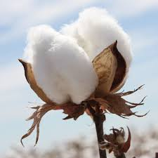
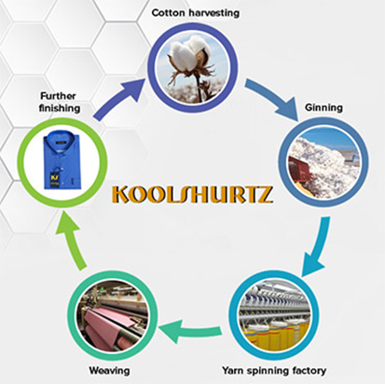
Aim And Objective
Aim of the dissertation is to predict the quality of raw cotton to give perfect pricing for both farmers and provide best quality of raw material for textile industries in India or outside India, with the help of machine learning approach
Objectives:-
To design a mechanism which will provide a way towards identifying cotton quality.
To provide a method which will automatically sort good quality and bad quality cotton without any human intervention.
To provide cost effective solution to various textile industries which are working in cotton fiber processing.

Slide 5
Literature Survey
CObject detection with OpenCV
Image Classification using Convolutional Neural Networks (CNN)
Image Processing is Going to Happen using Teachable Machine

Slide 6
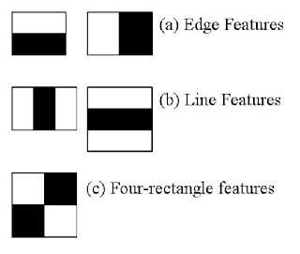
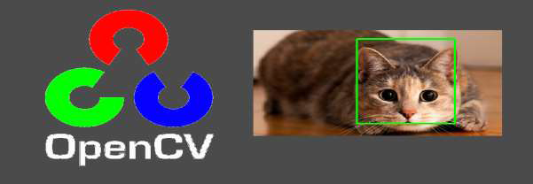
Object detection with OpenCV
A Hear feature considers adjacent rectangular regions at a specific location in a detection window, sums up the pixel intensities in each region, and calculates the difference between these sums. some the Hear features are shown in the following.
It is a machine learning-based approach where a cascade function is trained from a lot of positive and negative images. It is then used to detect objects in other images.

Slide 7
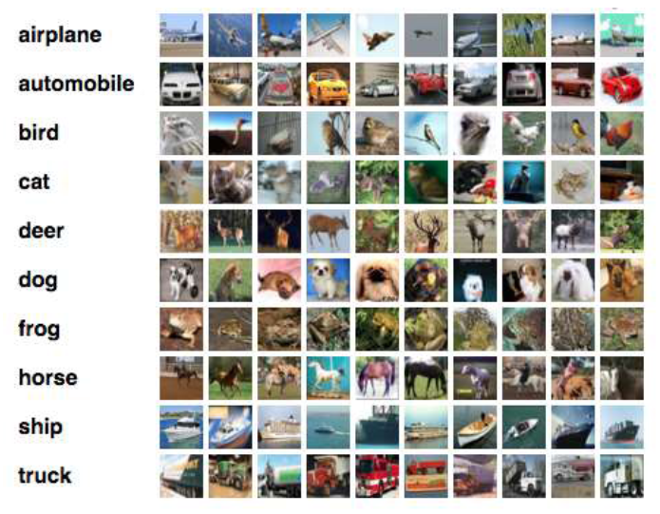
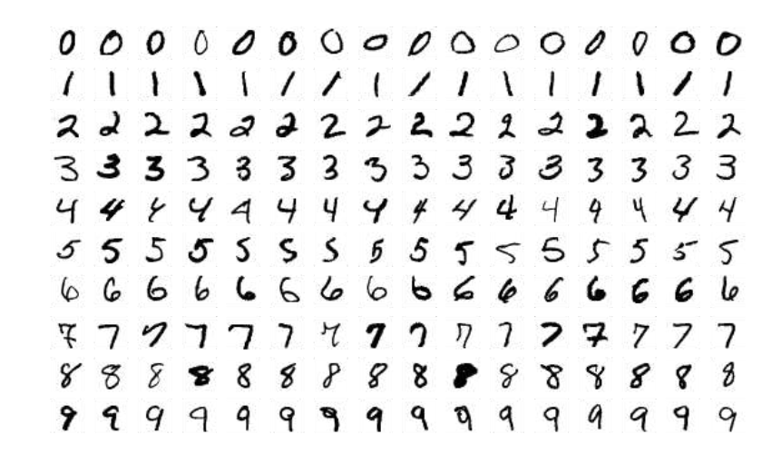
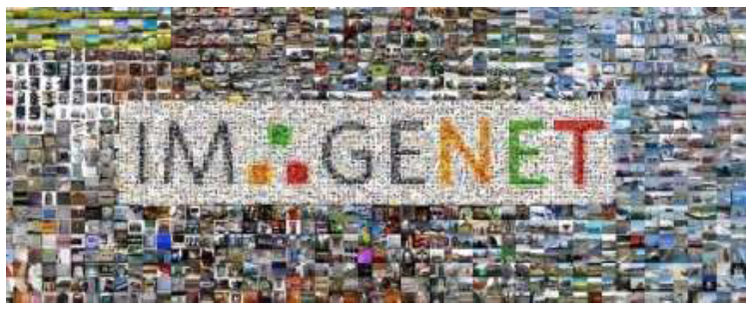
Image Classification using Convolutional Neural Networks (CNN)
1. Using CNNs to Classify Hand-written Digits on MNIST Dataset
2. Identifying Images from the CIFAR-10 Dataset using CNNs
3. Categorizing the Images of ImageNet using CNNs

Slide 8
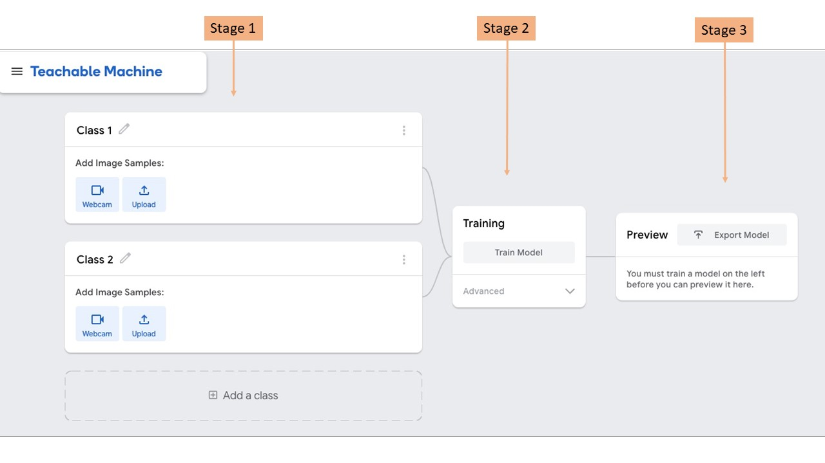
Image Processing is Going to Happen using Teachable Machine
Stage1: Gather data samples and pre-process the data
Stage2: Create a Suitable Machine Learning Model with Convolutional and Deep Neural Networks and Train it with your data
Stage3: Deploy the model and carry out Inference and Prediction

Slide 9
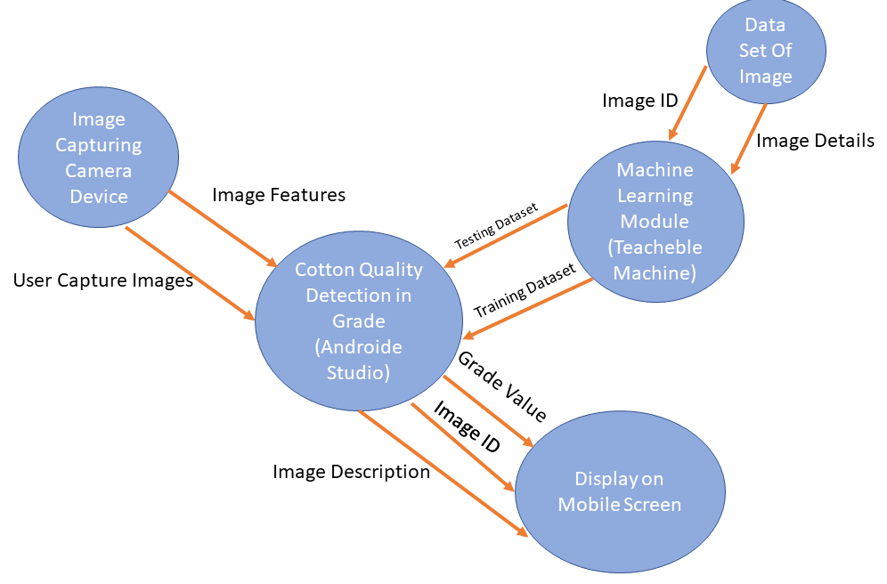
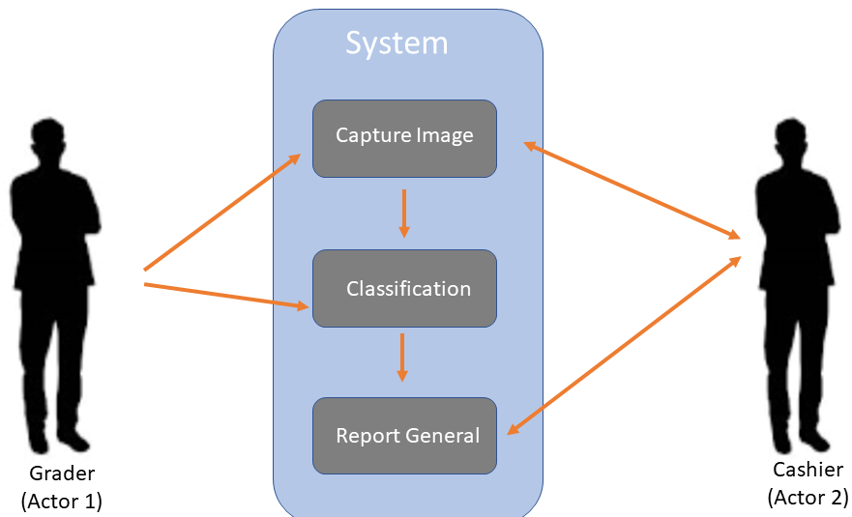
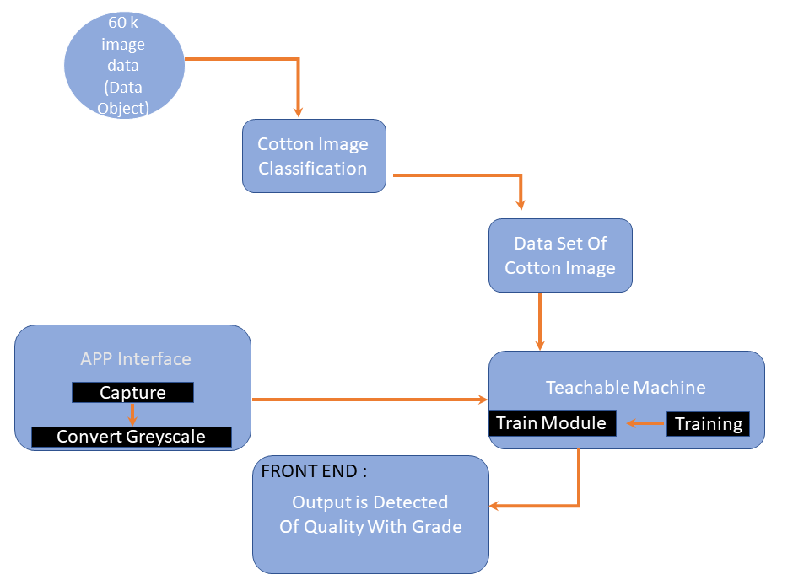
System Analysis
Context
Use Case
System Architecture

Slide 10
Implementations and Results
Training the Model
Deploying and Previewing
Exporting the model created using Teachable Machine
Screenshots

Slide 11
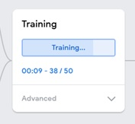
Training the Model
The model created using Teachable Machine tool is a Tensorflow.js model. The 'js' here is Javascript. It means that the process of inference and prediction on this kind of model is performed using javascript or in other words you simply need a browser. As per Teachable Machine, all the training happens in your browser, so everything stays in your computer.

Slide 12
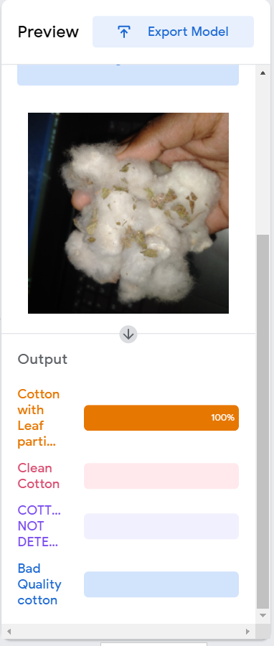
Deploying and Previewing
Once the training is finished, the trained model is deployed automatically and it starts providing the predictions on the inputs from camera. The accuracy of the model can be tested in the preview section of the tool. If the captured data was sufficient and categorized properly, the model will start recognizing the samples distinctly. When a sample is distinctly recognized, the percentage bar next to it approaches 100% as seen in the picture below.
Under the hood, the javascript code embedded in the app page continuously captures the images through cam. For each frame, the code performs inference using the model you just trained. The model returns prediction probabilities with respect to the classes it was trained with. More the resemblance with a class, higher its prediction probability. The picture shown below tries to emphasize the fact that for every webcam frame input,

Slide 13
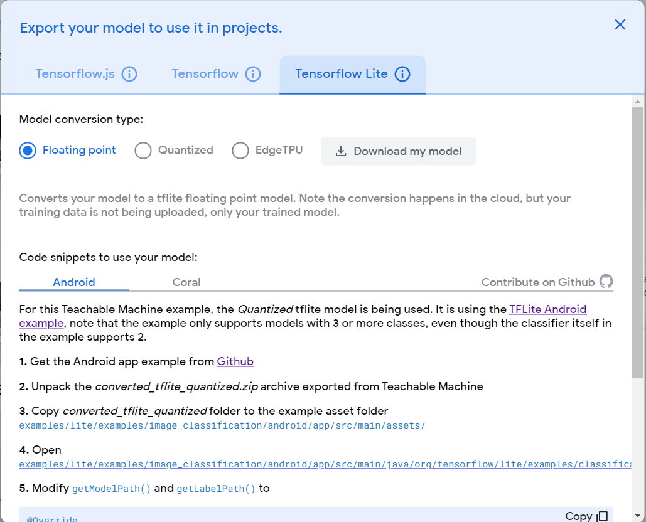
Exporting the model created using Teachable Machine
In order to use the model in other project, you need export it using 'Export Model' button in preview section. When you press 'Export Model' button, a screen appears as shown in the pic below. The key points to remember while downloading the model are annotated on the pic below.

Slide 14
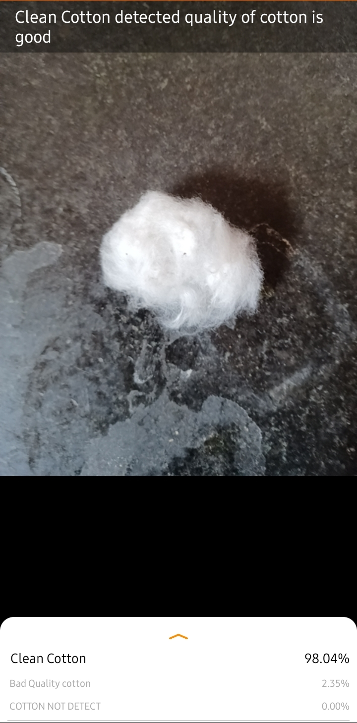
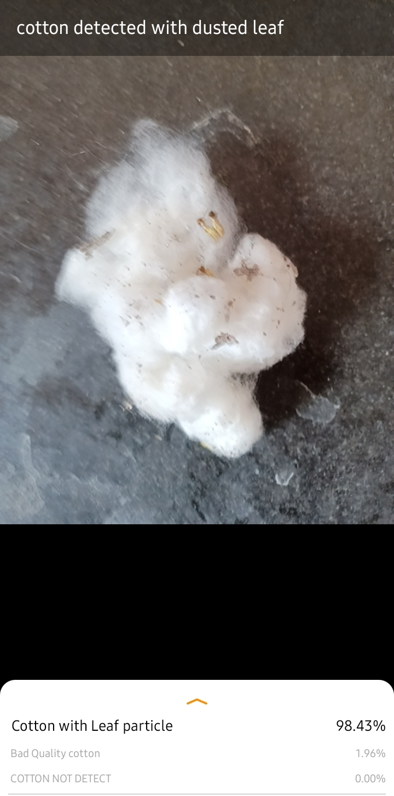
Screenshots
1. Clean Cotton Detected
2. Dusted Cotton Leaf Detected

Slide 15
Conclusion
It is very difficult and problem creating task for industry owner as well as for farmers. Quality plays vital role for ginning industry. So, it will be better to have scientific identification of qualities. Basic idea in the project is to identify the quality of cotton by using knowledge of computer, which help to identify quality in cotton industries. Image classification and segmentation is applied on raw cotton it will be better for the industries to finalize the purchase value& use of finished product in the market etc.

Slide 16
Thank You!

